Slide 1
أكـــــاديميــــة طــــويـــق
Artificial Intelligence Ethics

Slide 2
Ethical and Legal Considerations in AI
By: Dr. Afshan Hashmi

Slide 3
Course Objectives:
Analyze AI’s Impact on Human Rights
Assess Liability Frameworks for AI Decisions
Apply Legal and Ethical AI Principles
Interpret Global AI Regulations
Conduct Algorithmic Impact AssessmentsDebate Emerging Challenges in AI Ethics

Slide 4

Introduction to AI Ethics & Law
Why Ethics & Law Matter in AI
AI impacts privacy, employment, justice, and democracy
Risks: Bias, discrimination, surveillance, loss of autonomy
Need for legally compliant, fair, and accountable AI
Key Definitions
Term | Definition
AI Ethics | Moral principles guiding AI development & use
Algorithmic Bias | Unfair discrimination in AI decision-making
AI Liability | Legal responsibility for AI-caused harm
Right to Explanation | Legal requirement to justify AI decisions (e.g., GDPR)

Slide 5
Core Ethical Principles in AI
Fairness (Avoid bias in training data & decisions)
Transparency (Explainable & auditable AI)
Accountability (Clear responsibility for AI outcomes)
Privacy (Compliance with data protection laws)
Human Oversight (No fully autonomous high-stakes decisions)

Slide 6
AI and Human Rights
1. Privacy Rights & AI
Mass surveillance risks (e.g., facial recognition misuse)
Data protection laws:
GDPR (EU): Requires consent, data minimization, and right to erasure
CCPA (US): Gives users control over personal data
AI Privacy Risks:
Re-identification from anonymized data
Invasive profiling (e.g., targeted ads based on sensitive data)

Slide 7
2. Freedom & Autonomy
AI technologies can impact individual freedom and autonomy, which are fundamental human rights. Let’s break down how:
AI in Social Media: Filter Bubbles, Misinformation, and Manipulation
Filter Bubbles: Algorithms personalize content based on your behavior, likes, and clicks. This means you only see content that agrees with your views — limiting exposure to diverse perspectives.
Impact: Reduces critical thinking and can polarize society.
Misinformation: AI-driven bots or poorly regulated content recommendation systems can spread false information rapidly.
Ethical Concern: Users are manipulated into forming opinions or beliefs based on inaccurate data.
Manipulation: AI can be used to manipulate emotions, voting decisions, or purchasing behavior (e.g., Cambridge Analytica scandal).
Freedom at Risk: People may make choices influenced by hidden AI nudges, rather than true free will.

Slide 8
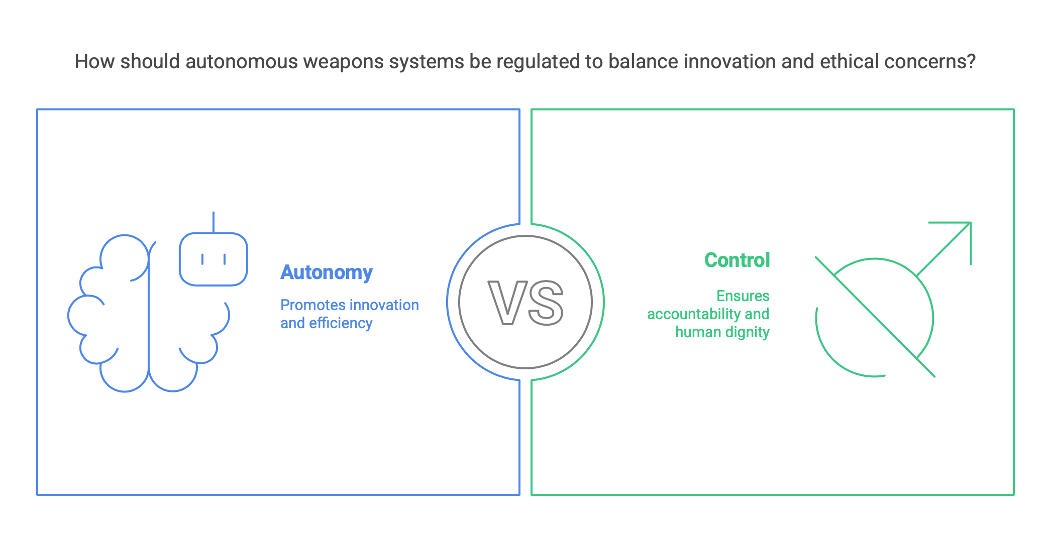
Autonomous Weapons: Ethical Concerns Over AI-Driven Warfare
These are weapons systems that can select and attack targets without human intervention.
Key Ethical Issues:
Who is responsible if an AI weapon makes a mistake?
Can machines ethically decide to take a life?
Lack of transparency and accountability in lethal decisions.
Autonomy vs. Control: When machines have the power to kill without human judgment, we risk undermining human dignity and international law.

Slide 9
Job Displacement: Ethical Responsibility in Workforce Automation
AI is replacing jobs in manufacturing, customer service, driving, etc.
Example: Self-driving trucks replacing truck drivers.
Concerns:
Loss of livelihood for many workers.
Increased inequality if reskilling programs or safety nets are not provided.
Ethical Duty: Companies and governments have a responsibility to ensure:
Fair transitions
Access to retraining and education
Protection of workers' rights
Issue | AI Concern | Impact on Freedom & Autonomy
Social Media | Filter bubbles, manipulation | Limits free thought & informed choice
Autonomous Weapons | Lethal AI decisions without human input | Violates human control & dignity
Job Displacement | Automation without support for workers | Undermines economic autonomy

Slide 10
Non-Discrimination & Bias Mitigation
AI systems must be fair, just, and non-discriminatory. Unfortunately, many real-world systems unintentionally reinforce or even amplify biases. This section explores where bias comes from and how we can address it.
Sources of AI Bias
AI bias doesn't just happen — it’s often the result of decisions made during development. Let’s break it down:
1. Biased Training Data
What it means: If the historical data used to train the AI is biased, the AI learns those same patterns.
Example:
A hiring algorithm trained on past data that favored men over women might learn to prefer male candidates.
Facial recognition systems that perform poorly on people with darker skin tones because the training data lacked diversity.
Result: Discrimination in predictions or decisions — even if unintentional.

Slide 11
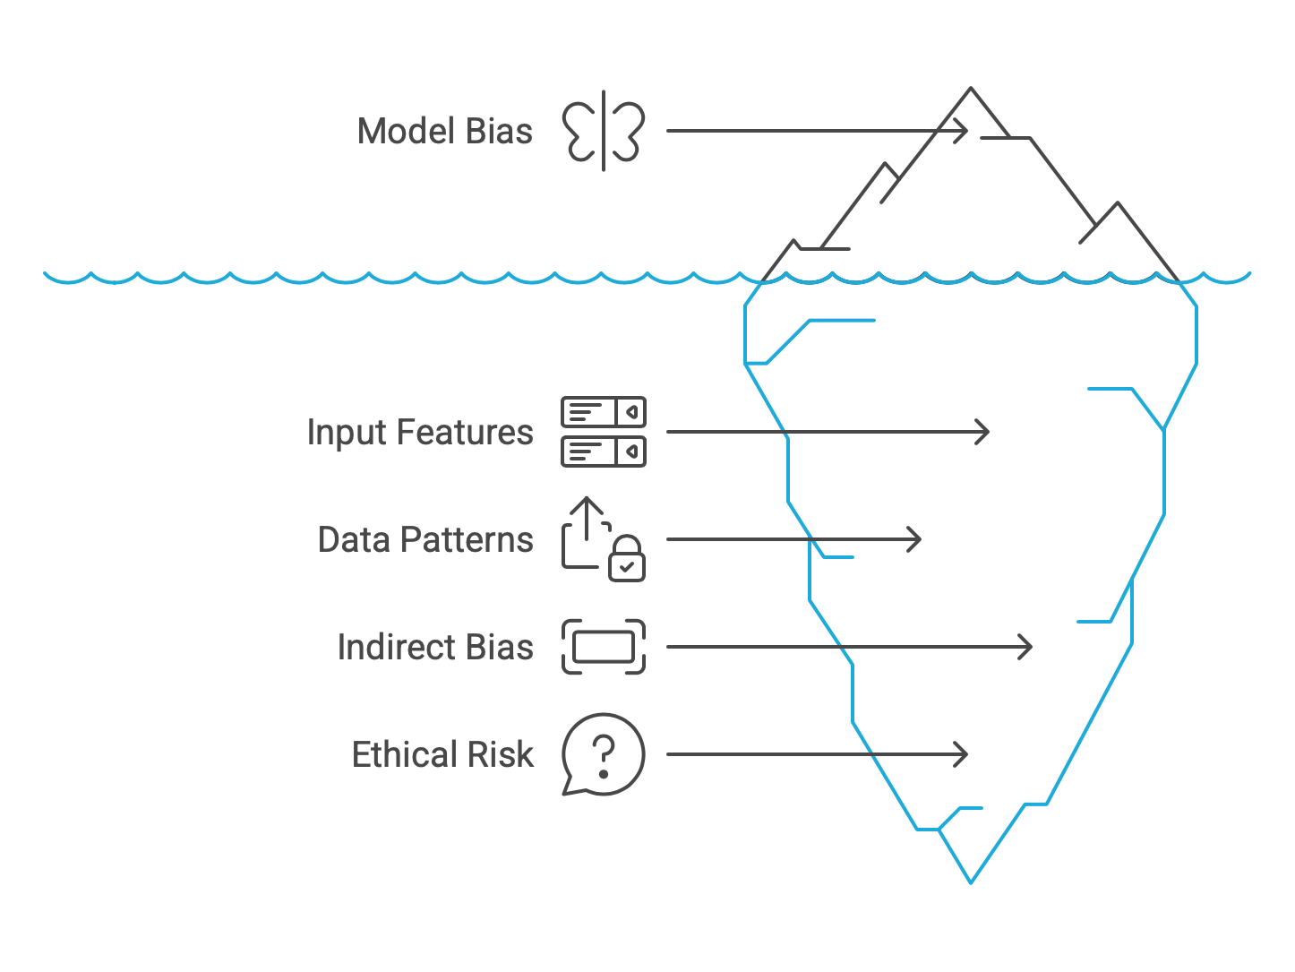
2. Flawed Model Design
What it means: Sometimes, models indirectly learn sensitive attributes through proxies.
Example:
A loan approval model may not use race explicitly but uses ZIP code — which can correlate with race or socioeconomic status.
Ethical Risk: Even if sensitive features aren’t used, indirect bias can still creep in.

Slide 12
Mitigation Strategies
Now let’s look at how we can prevent or reduce bias in AI systems.
1. Fairness-Aware Machine Learning
These are ML frameworks designed to measure and reduce bias in predictions.
Popular Tools:
IBM’s AIF360 (AI Fairness 360):
Open-source library that helps detect and mitigate bias.
Provides fairness metrics and bias mitigation algorithms.
Google’s Fairness Indicators:
Tools for TensorFlow that track performance across different subgroups.
Use Case: Monitor whether your model treats all groups fairly before deployment.

Slide 13
Mitigation Strategies
2. Bias Audits (Pre- and Post-Deployment)
What it means: Regular checks to see if bias exists before launching the AI system (pre-deployment) and while it is running (post-deployment).
Why important:
Systems may become biased over time as they adapt to new data.
Ethical & legal accountability requires ongoing monitoring.
Source of Bias | Example | Solution
Biased Training Data | Historical discrimination in hiring data | Diverse datasets, fairness-aware tools
Flawed Model Design | ZIP code as a race proxy | Careful feature selection, bias testing
Unchecked Post-Deployment | Drift in predictions over time | Regular bias audits

Slide 14
Liability & Accountability in AI Decisions
Who is Responsible When AI Fails?
As AI systems make increasingly impactful decisions — from medical diagnoses to loan approvals to driving vehicles — the question of liability becomes critical: Who should be held accountable when things go wrong?
Scenario-Based Accountability
Scenario | Potential Liable Party
Faulty medical diagnosis AI | Developer, Hospital, Regulatory Body
Autonomous car accident | Car Manufacturer, Software Provider, Driver
Discriminatory hiring algorithm | Company, HR Department, AI Vendor

Slide 15
Explanation:
Developer: Poor model design, inadequate testing, or known flaws.
Organization (Hospital/Company): Responsible for deploying and relying on the AI system.
Regulatory Bodies: May share blame if oversight was insufficient.
Vendors/Manufacturers: Liability for faulty hardware/software used in the AI system.
End Users: When human override is possible but neglected.

Slide 16
Legal Theories of AI Liability
1. Product Liability
Concept: If an AI system is sold as a product, and it's defective, it can be treated like a faulty product.
Example: A medical device powered by AI gives a wrong dosage recommendation due to a bug.
2. Negligence
Concept: Failure to take reasonable care during AI development or deployment.
Example: Ignoring testing warnings or skipping safety evaluations before launching an AI-powered feature.
3. Strict Liability
Concept: Applies to high-risk AI systems liability is assigned even if no fault is proven.
Example: An autonomous drone crashes into private property the owner/developer is liable regardless of intent.

Slide 17
Accountability Mechanisms in AI Systems
To address and prevent failures, organizations can implement the following:
1. Audit Trails
What: Logging each decision the AI makes and the data it used.
Why: Enables post-incident analysis and compliance checks.
Example: If a patient is denied care, logs can show why the AI decided so.
2. Human-in-the-Loop (HITL)
What: Human oversight on critical decisions (especially life-altering or high-risk ones).
Example: An AI recommends surgery, but the final decision is reviewed by a doctor.
3. Explainability Tools
Tools:
SHAP (SHapley Additive exPlanations) – Shows feature contribution to decisions.
LIME (Local Interpretable Model-agnostic Explanations) – Explains predictions locally.
Why: Helps justify and audit decisions, important for legal defense and public trust.

Slide 18
Accountability Mechanisms in AI Systems
As AI becomes more autonomous, shared responsibility between developers, deployers, and regulators becomes essential. Clear documentation, transparent models, and human oversight are key pillars of AI accountability.
Failure Type | Liability Pathway | Mitigation Mechanism
AI misdiagnosis | Negligence / Product Liability | Audit logs, Explainability, HITL
Self-driving crash | Strict Liability / Manufacturer Fault | Black boxes, Sensor audits, Human override
Algorithmic discrimination | Company & Vendor negligence | Bias audits, Transparency tools

Slide 19
Key Global AI Regulations
As AI becomes integrated into critical sectors like healthcare, finance, and transportation, governments are establishing regulations to protect citizens' rights, promote fairness, and reduce risks. Below is an overview of major global and industry-specific regulations.
Regulation | Scope | Key Requirements
EU AI Act (2024) | Risk-based regulation | Bans harmful AI (e.g., social scoring); strict rules for high-risk AI systems
GDPR (EU, 2018) | Data protection | Right to explanation, data minimization, consent for automated processing
Algorithmic Accountability Act (US, Proposed) | Bias audits | Requires impact assessments for AI & automated decision systems
China’s AI Regulations | Algorithmic transparency | Requires disclosure of decision-making logic in some AI systems

Slide 20
Industry-Specific AI Regulations
Industry | Regulation | Focus
Healthcare | FDA AI/ML Software as a Medical Device | Requires validation, monitoring, and post-market updates
Finance | FRB / EU AI in Finance Guidelines | Prevent discrimination in credit scoring & lending
Automotive | UNECE WP.29 (UN regulation) | Cybersecurity, software updates, self-driving safety

Slide 21
RECAP
Understand AI’s impact on privacy, freedom, and non-discrimination
Learn legal liability models for AI-caused harm
Compare global AI regulations (EU AI Act, GDPR, US proposals)
Analyze real-world AI legal cases (Clearview AI, Tesla Autopilot)
Implement bias detection & compliance strategies
Track emerging AI laws (UN, ISO standards)

Slide 22
Resources for Further Study
Further Resources
EU AI Act Documentation
OECD AI Principles
IBM AIF360 Toolkit
SHAP Documentation

Slide 23
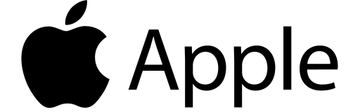

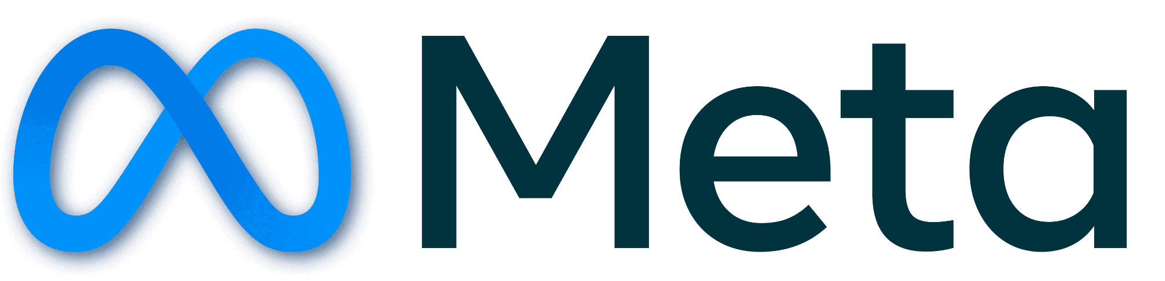





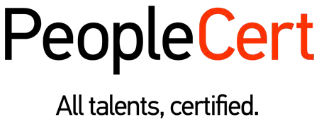
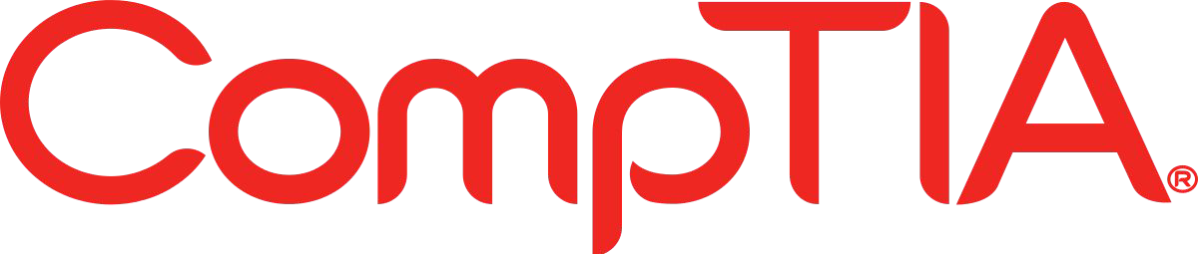







الشراكات العالمية

Slide 24
شــــــكــــرًا لكــــــم
THANK YOU

